Slide 1
Advanced C#
Hack Your Future (https://hackyourfuture.be/)
Axxes Coaches
Hannes Lowette
Joren Vandekerckhove
Kevin Boets
Stijn Roscam
Thibaut Humblet
Francis Didden

Slide 2
Generics
Maximize code reuse, type safety, and performance.
Built in existing .NET Collections
Notes:
Generics introduced the concept of type parameters. We can make a class that takes a generic yet undefined/generic type.
The actual implementation defines the type.

Slide 3
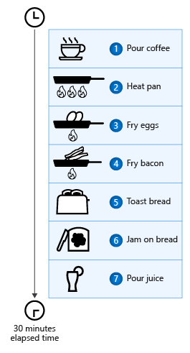
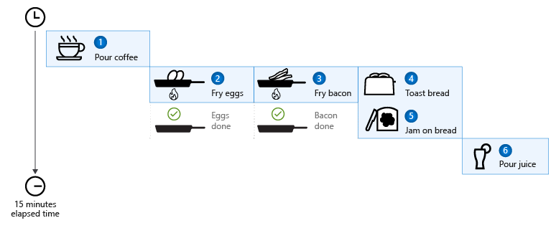
Async / Await
Unblock UI
Effecient processor usage
Useful in frontend and backend
Task & Task<T>

Slide 4
Nuget Packages
Demo

Slide 5
Unit testing basics
Xunit
Test the smallest logical unit

